Slide 1
Beyond Borders
Promoting inter-professional partnerships
Ma. Theresa arranz-Lim md fpps fpsdbp

Slide 2
What is a developmental pediatrician?
Medical doctor trained in Pediatrics ( Pediatric Physical illness)
Training in NORMAL Growth, Development, Behavior of Children
Studied on impact of illness on these domains
Training in detection, diagnosis and management of conditions affecting the above

Slide 3
Straddles many
specialties namely
Medical:
Pediatrics
Neurology
Psychiatry
Rehab medicine
Psychological
Ties in with Educational
as it affects a child's
Overall development

Slide 4
DISCLAIMERS and APOLOGIES
Collaboration History
What has aided in making these collaboration fruitful
How has this contributed to patient care

Slide 5
COLLABORATION HISTORY
Notes:
I started my practice feeling quite alone and isolated, having been trained in the UP-PGH system which in itself seems like a self contained community. Coming from a medical model, I needed to adapt to a paradigm shift from being captain of the ship, boss and commander of the patient-doctor relationship to working within a team comprised of the paramedical professions as well as the psychologist, and social worker. Being in Pediatrics, of course gave me the training to deal qith two or more patients Parent and child but the dynamics of even that changed as ai now had to also consider extended family.

Slide 6
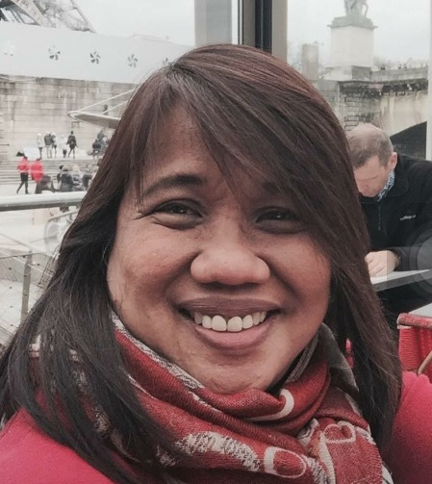
Networking with
Agencies
particularly
For Cleft Lip/Palate
and
Hearing Impaired Children
Perpetually checking if UP CAMP grad
UST
Notes:
Thus I decided to creat a small multidisciplinary clinic with a psychologist and SP in tow. But thats going ahead of the story. My first encounter and collaboration was with a person who knew all about cleft lip and palate, who fortuitously was a churchmate and friend in the person of . . .
This friend gave me insight into the trappings of networking and the need to know resources here and abroad for specific cases, he introduced me to the Cleft palate clinic in a charity hospital nearby ad the John Tracy system. Little did I know he would also be my personal reference for determining who the real or fake SP's were. Later on with his good friend, Gigi , Bal or Sir Bal to many would frequently get a call, text to verify . . . "Sa inyo ba ito?"

Slide 7
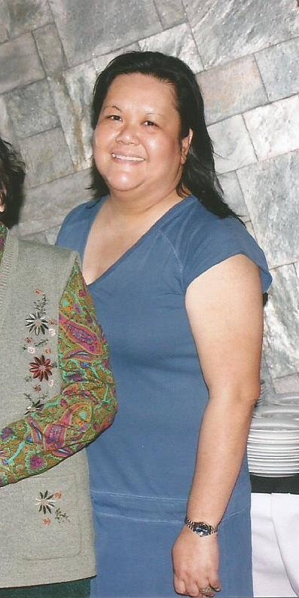
Start of group
Practice
First Interesting
Case
Korean boy
Bravely took on
Children who wouldnt
sit or pay attention
Notes:
Anyway as I said ,my group practice started with an SP GRAD in practice for 3-4 years then, who was in a school system or did home visits. One of our first interesting cases was a Korean boy who I could swear had the signs of autism at first glance. And with a language barrier to elicit a reliable history, my colleague embarked on a brave attempt to handle this boy DE NOVO. After a few sessions we were both pleasantly surprised to find out, he could talk and responded quite well! Hindi pala. DLD LANG WITH ATTENTION DEFICITS

Slide 8
First conundrum: Apraxia?

Slide 9
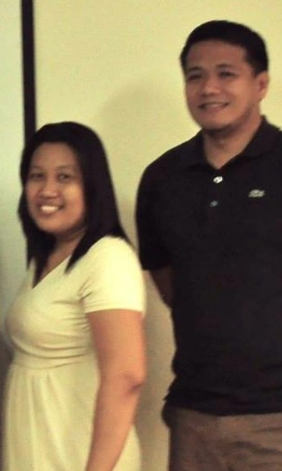
Limits of
Assessment
Vs
Clinical presentation
Stuttering
Dynamic Duo
Selective Mutism

Slide 10
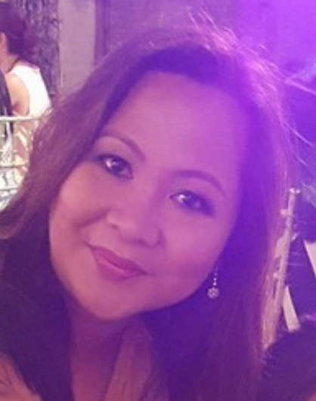
ABA entry

Slide 11
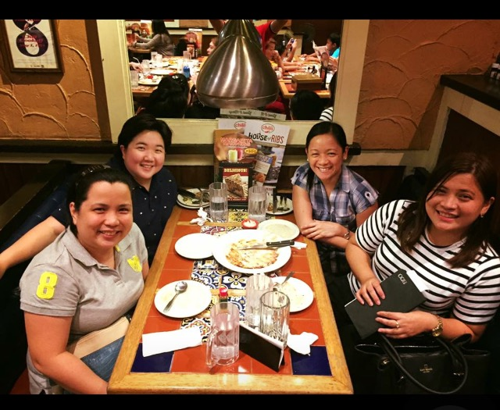

Slide 12
Up Camp dept Of speech pathology
Angeles u camp pt/OT DEPT.

Slide 13
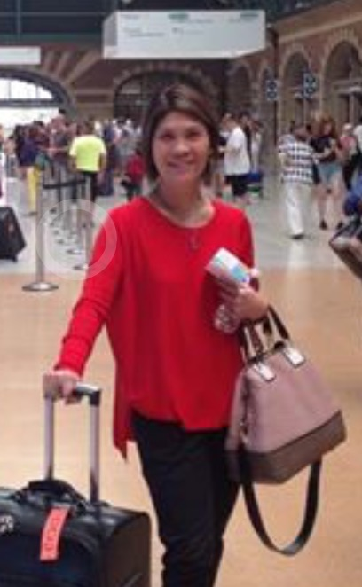
Oral Placement
Therapy
PROMPT
Notes:
I also had a personal journey of seeing my own adopted daughter in the hands of two very dedicated and talented therapist who remain my friends to this day. In the course of my daughter's intervention I discovered two techniques which I really felt were the sole perview of the SLP's, these are

Slide 14
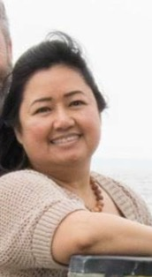
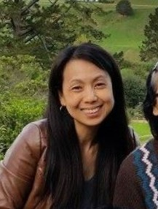
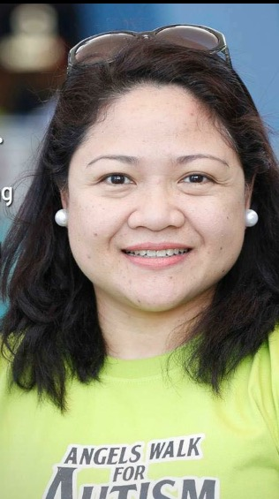

Slide 15
What has aided in making collaboration fruitful

Slide 16
What has aided in making collaboration fruitful
Effective and honest feedback
Openness to questions/willingness to learn
Generosity to teach
Initiative to effect a collaboration
Professional conduct
Notes:
1) Effective and Honest Feedback
One of the biggest pet peeves we encounter is when a parent complains that they are confused with the feedback of the therapist esp with regards the diagnosis of the child does not jive with the doctor. Often this leads to doctor shopping which adds to the already long waiting list.
Admittedly, the time spent by the doctor and the therapist are worlds apart and the interaction is much more diverse and dynamic. Letting the doctor know which areas of conflict or inconsistence, esp if videos are presented help us see the big picture. After all, its called developmental as the child's manifestations should progress over time, hopefully in a positive way. I always caution the parents that my impression is never cast in stone but certain markers, red flags leads to certain impressions
2) openness to Q needs to cut both ways. I greatly appreciate the willingness of the therapists I have worked with to be asked hard questions not to challenge them but often to understand their terms, the practice, to see what they are seeing in therapy. I have to admit I can be demanding with regards reports esp when i want to see a particular aspect of language not reported about or not addressed. So sometimes I ask certain tools be used and I appreciate reports that explain the process not just the result. THEN I can better demystify and explain to the parent the patient's condition. PRESS TO NEXT SLIDE

Slide 17
What has aided in making collaboration fruitful
Effective and honest feedback
Openness to questions/willingness to learn
Generosity to teach
Initiative to effect a collaboration
Professional conduct

Slide 18
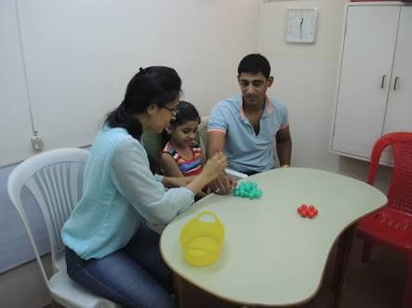
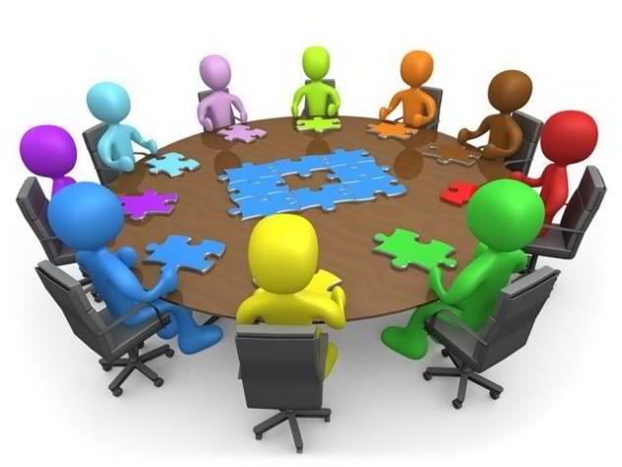
Steps Taken
observed evaluations and familiarized self with evaluation materials to know what information you can derive from the test
2) observed therapy sessions to see how
goals are met
3) ask parents' feedback whether
therapists' goals and explanations
were clear
4) facilitate meetings / team conferences

Slide 19
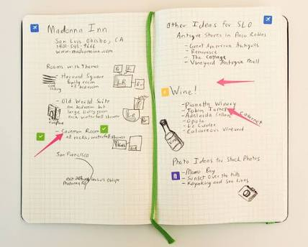
Steps Taken
5) Doctor's notes / Therapist's
notes and reports
6) Feedback through email/text
7) request for meeting/PTC
8) school or home visit
9) updates in conferences
workshops, books,journals
Notes:
Just a word about PTC's. This is another learning venue for me to integrate the puzzle that is the child. I often cite the parable of the 5 blind men and how each one's understanding of what the elephant is can be tainted by their orientation, limited vision or experience. Much as I would like to be the center of the universe, this very informative meeting helps me get to know how a clinician is thinking and vice versa, gives me insight into possible options to advise and gives the parents an appreciation of the team member's role and value.

Slide 20
How has this contributed to patient care

Slide 21
How has this contributed to patient care
Patient compliance
Parental trust
Professional trust and confidence
Notes:
Patient Care
Parents need to be enjoined as partners in Patient care,as such they need to understand the philosophy of management and need to be able to see if strategies given are working.
Furthermore, generalization needs to occur and what better way than real life experience and practice which parents can do. so when I see notes like. " MLU INCREASE, WH-Q, Sentence construction, obeys with 3-4 critical elements but no examples . . . Duhhhhh, the parents give me a blank face if the child can do this.
Notes I appreciate usually will put at least ONE or more examples of what was done, and when I see this, I feel the obligation to tell parents, to practice, pay attention to what the clinician said and even ask for their examples. The need to demystify is sooooo great.
Once the parents trust the clinician with their child, doctor/therapist shopping is minimized and even I am able to defend the clinician from misperceptions of the family. Gone are the days when the minute the child talks the parent chooses to drop therapy. With better rapport, i find they are willing to stick by their child's teacher

Slide 22
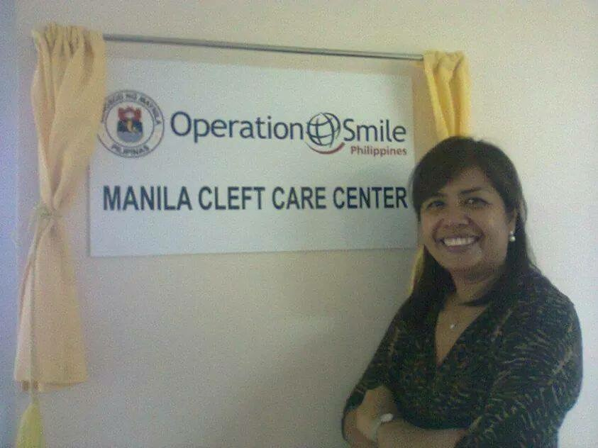
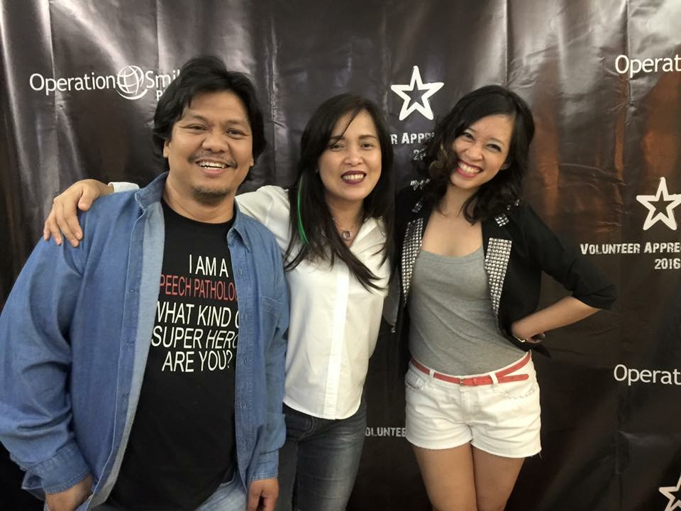
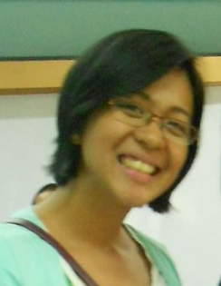
Notes:
Just a side bar, another activity I deeply appreciate the center generated aids to management of the children i.e. Parenting classes and outreaches where clinicians are able to work alongside each other and learn more about each other's assessment, how they view the patient and what they may see that another might not.

Slide 23
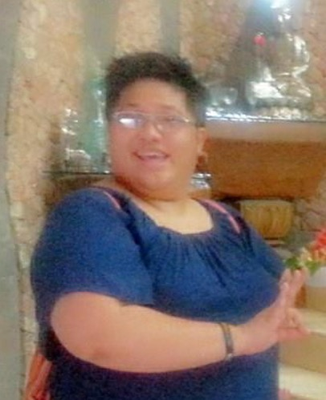
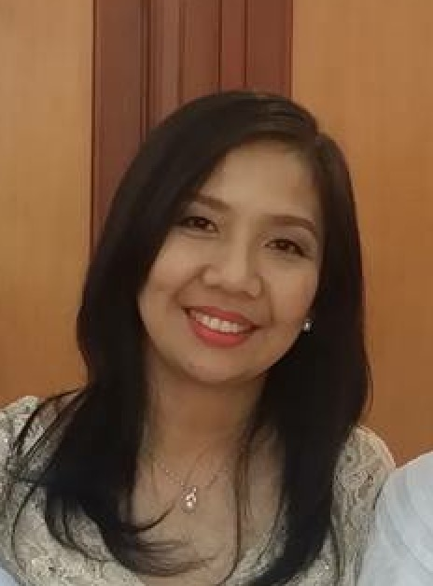
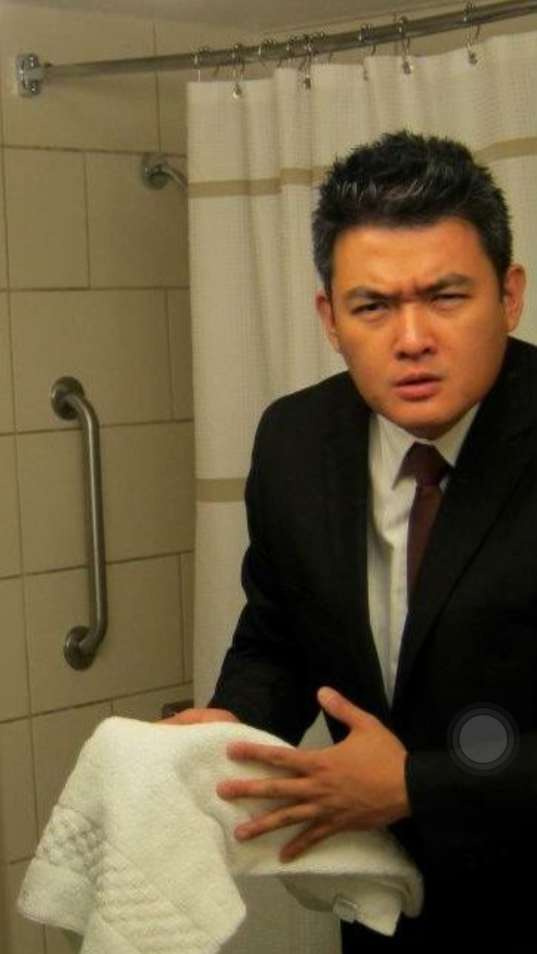
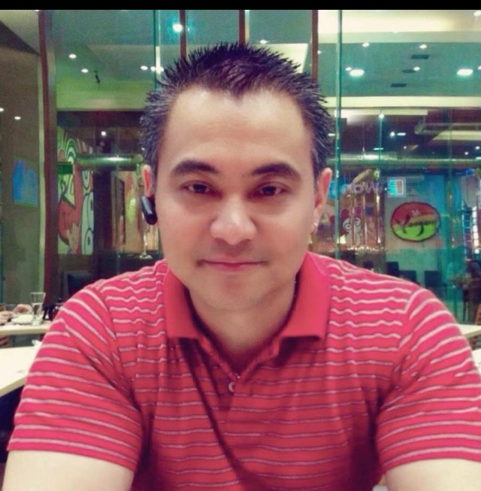
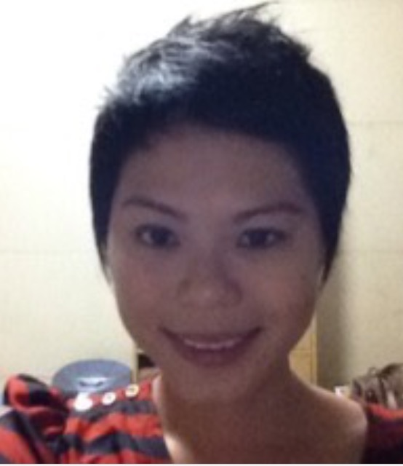
Notes:
Then of course, the returnees are a great fund of information for me.

Slide 24
Humility
Hearing
Heeding
Helping

Slide 25
Beyond Borders
Promoting inter-professional partnerships
Ma. Theresa arranz-Lim md fpps fpsdbp

